Slide 1

TOTAL TECHNOLOGY
REPORTLAB COMPLETE TUTORIAL
How to GENERATE MULTIPLE FRAMES IN PDF USING PYTHON
Tutorial 53

Slide 2
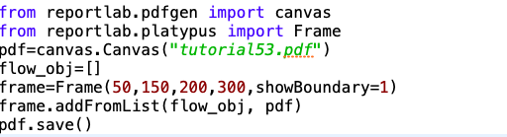
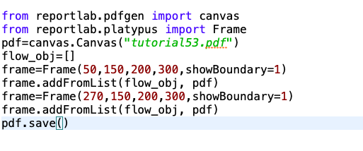
For single frame
HOW TO CREATE MULTIPLE FRAMES IN SAME PAGE
For two frames sideb by side
TOTAL TECHNOLOGY

Slide 3
HOW TO CREATE MULTIPLE FRAMES IN SAME PAGE
TOTAL TECHNOLOGY

